Slide 1






Introduction
https://linkedin.com/in/aseefahmed
Aseef Ahmed
www.youtube.com/@cloudindepth
Humm Group - Sr. Site Reliability Engineer (SRE)
• 5+ years experience in cloud architecture and startup scaling
• Worked for giants like Deloitte, AWS, and NZ Ministries
• Mentors students, fresh graduate to onboard them into the world of Cloud Computing & DevOps
Session Objectives
Startups
Cloud
Global Reach
• Understand the unique scaling challenges startups face
• Learn strategic approaches to cloud adoption and scaling
• Explore real-world examples of successful cloud scaling
• Identify common pitfalls and how to avoid them
2

Slide 2

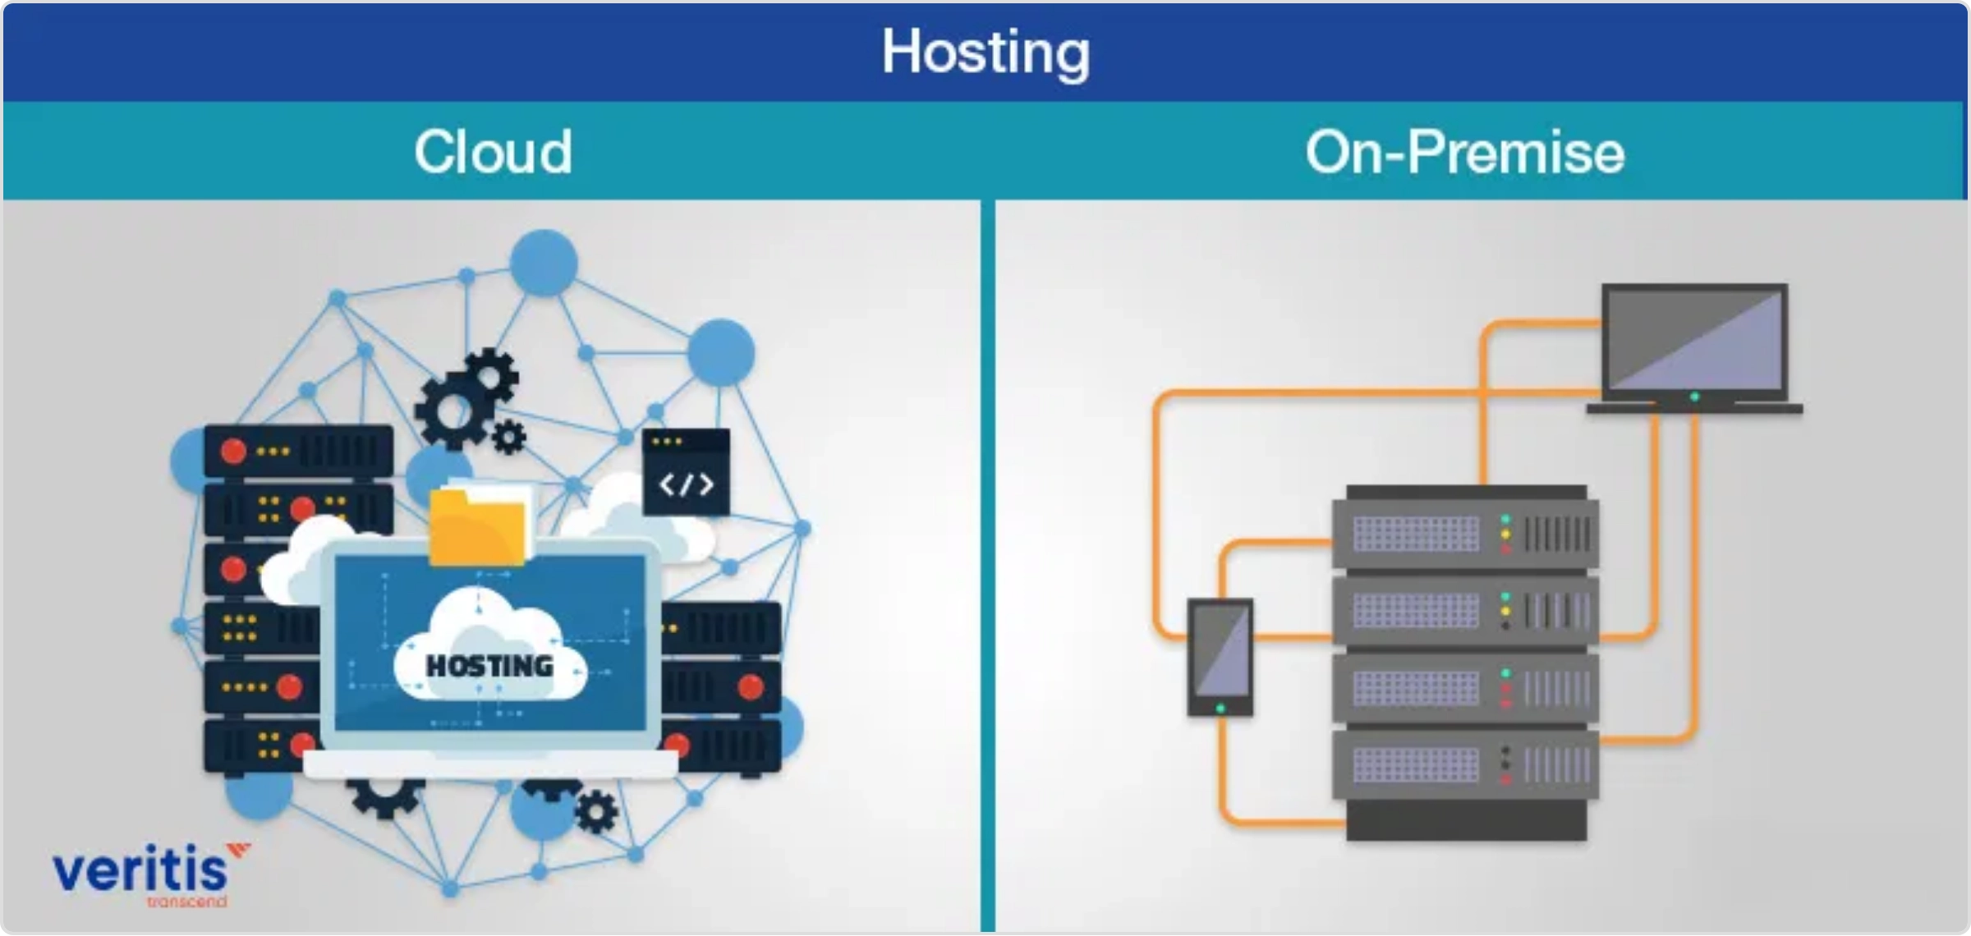



Why the Cloud?
Cost-effective Infrastructure
Pay-as-you-go model eliminates large upfront capital expenses. Scale resources up or down based on actual needs, optimizing costs.
Global Accessibility & Low Latency
Deploy applications in multiple regions worldwide with a few clicks. Content delivery networks (CDNs) ensure low latency for global users.
Auto-scaling for Demand Spikes
Automatically adjust resources based on traffic patterns. Handle viral growth or seasonal peaks without manual intervention.
DevOps and CI/CD Support
Built-in tools for continuous integration and deployment. Streamlined development workflows accelerate time-to-market.
4

Slide 3

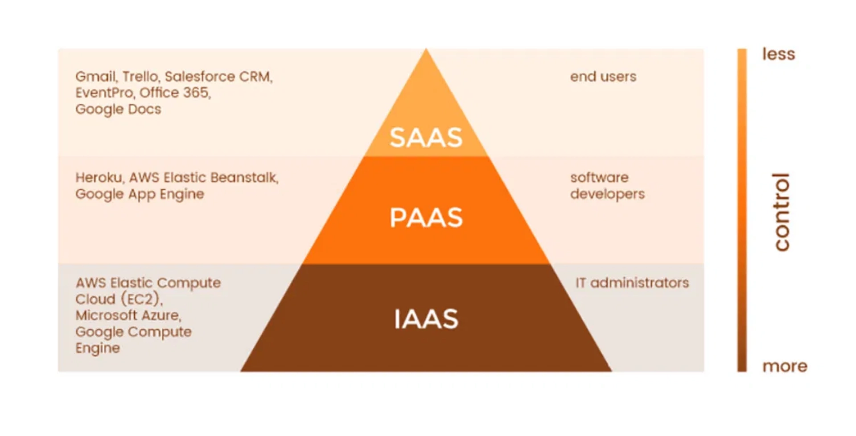
Cloud Models
Model
Description
Pros for Startups
Cons for Scaling
Ready-to-use applications
Immediate use, no maintenance
Limited customization, potential vendor lock-in
SaaS
(Software as a Service)
PaaS
Development & deployment environment
Focus on code, not infrastructure
Platform constraints, less control
(Platform as a Service)
IaaS
Virtual machines & networking
Maximum flexibility & control
More management overhead
(Infrastructure as a Service)
Best Practice:
Many startups begin with a hybrid approach - using SaaS for non-core
functions, PaaS for rapid development, and IaaS for specific performance needs.
5

Slide 4
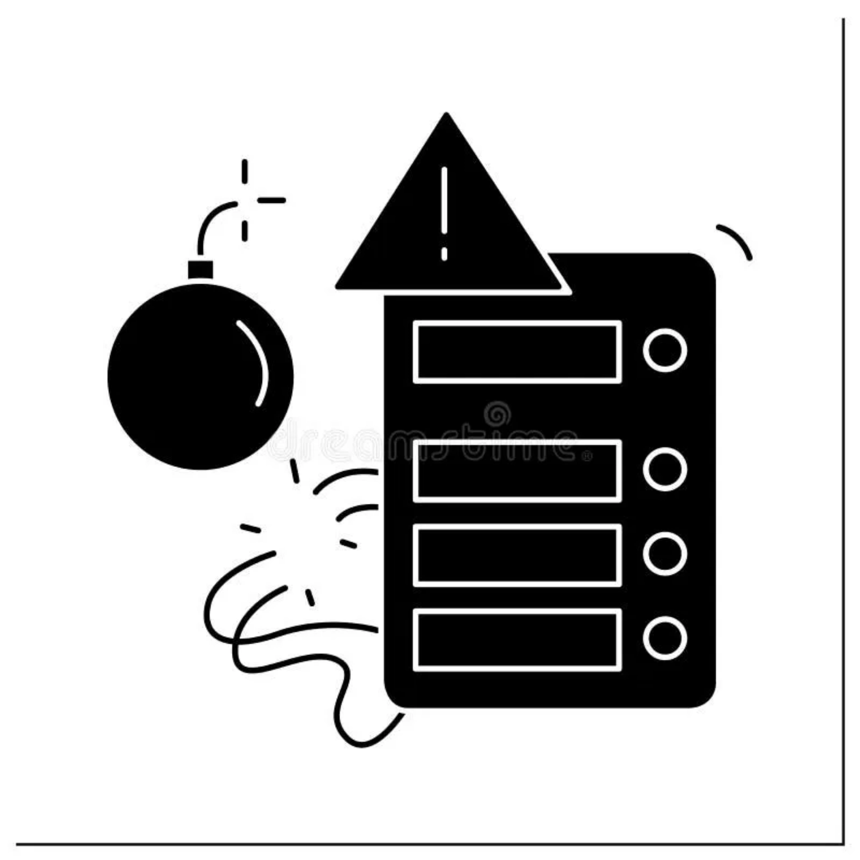




Scaling Challenges
Traffic Spikes & Unpredictable Demand
Sudden viral growth can overwhelm systems. Cloud auto-scaling helps, but requires proper configuration and testing to handle 10x or 100x traffic surges.
Multi-region Deployment
Global expansion requires deploying to multiple regions. Challenges include data replication, regulatory compliance, and maintaining consistent user experience across regions.
Data Consistency & Latency
Distributed systems face the CAP theorem trade-offs. Balancing consistency, availability, and partition tolerance becomes critical as you scale across regions.
Cost Management
Cloud costs can spiral without proper monitoring and optimization. Implementing cost governance early prevents unexpected bills as you scale.
When systems aren't designed for scale, performance degrades under load, leading to poor user experience or outages.
6

Slide 5

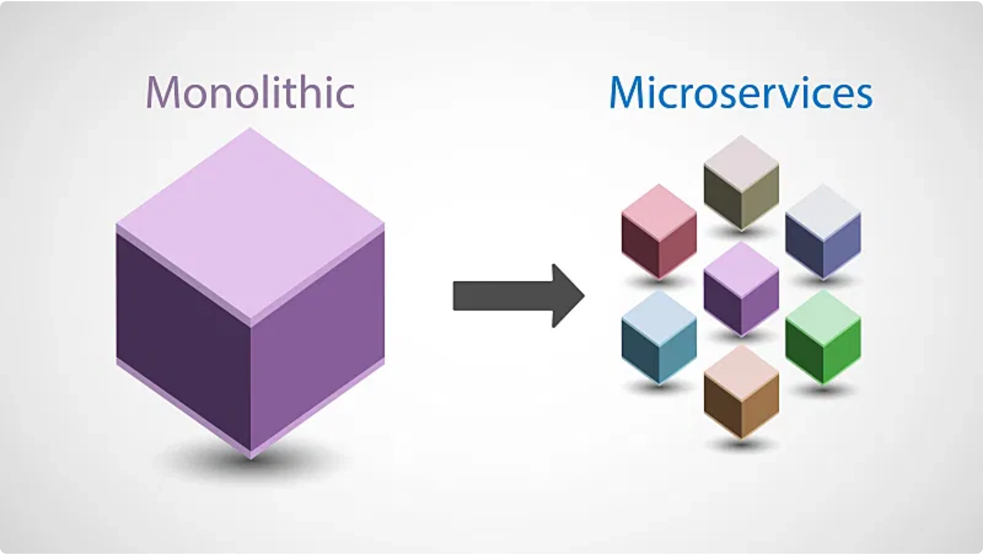
Architecture for Scale
Aspect
Monolith
Microservices
Development
Simpler initially
More complex setup
Scaling
Scale entire app
Scale individual services
Resilience
Single point of failure
Isolated failures
Deployment
All-or-nothing
Independent deployments
Team Structure
Single team
Multiple specialized teams
Serverless Functions for Rapid Scaling
Zero infrastructure management
Automatic scaling to match demand
Pay only for execution time
Ideal for event-driven workloads
7

Slide 6

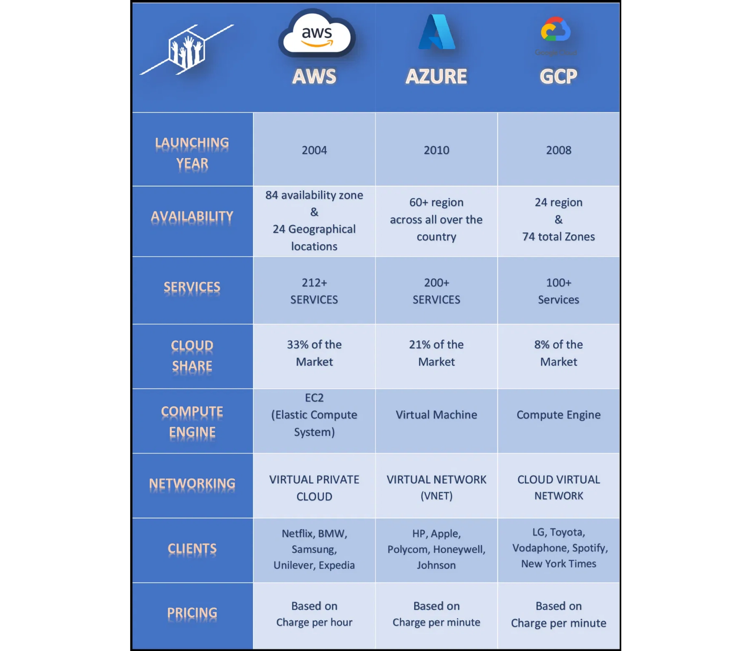
Cloud Providers Comparison
Provider
Strengths
Best For
AWS
Mature, most services
Enterprise, broad needs
Azure
Microsoft integration
.NET, Windows workloads
GCP
Data analytics, ML/AI
Data-driven applications
Case Example: Slack on AWS
Scaled to 10M+ daily users with ECS & DynamoDB
Achieved 99.99% uptime during rapid growth
8

Slide 7

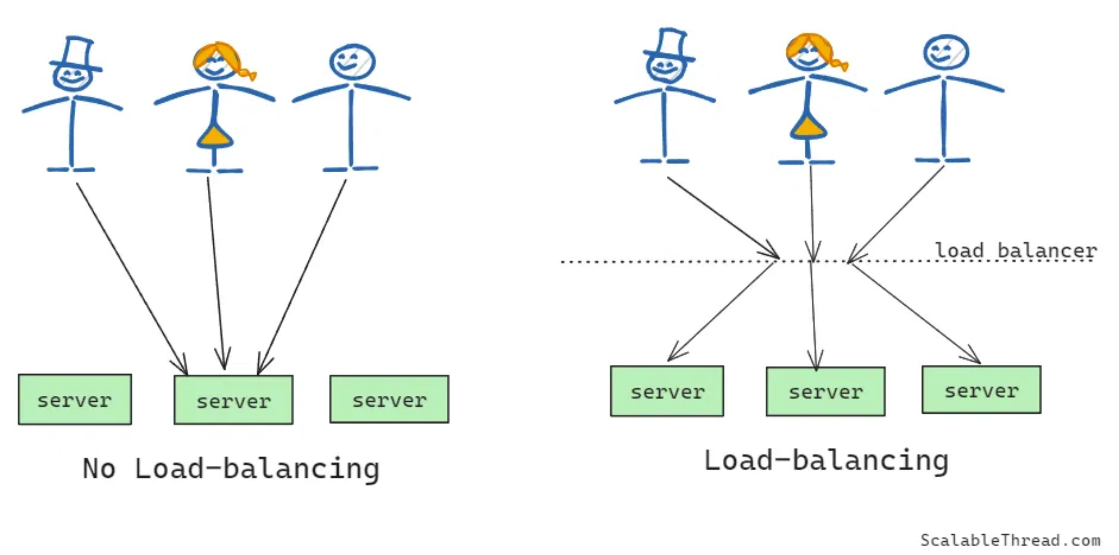
Auto-scaling & Load Balancing
Scaling Approaches
Vertical Scaling
Horizontal Scaling
Add more resources to existing servers
Add more server instances
Virtually unlimited scaling potential
Simpler to implement
Higher availability and fault tolerance
Limited by hardware capacity
Potential downtime during upgrades
Requires load balancing
Cloud Auto-scaling Examples
AWS EC2 Auto Scaling
Azure VM Scale Sets
Kubernetes HPA
GCP Managed Instance Groups
9

Slide 8

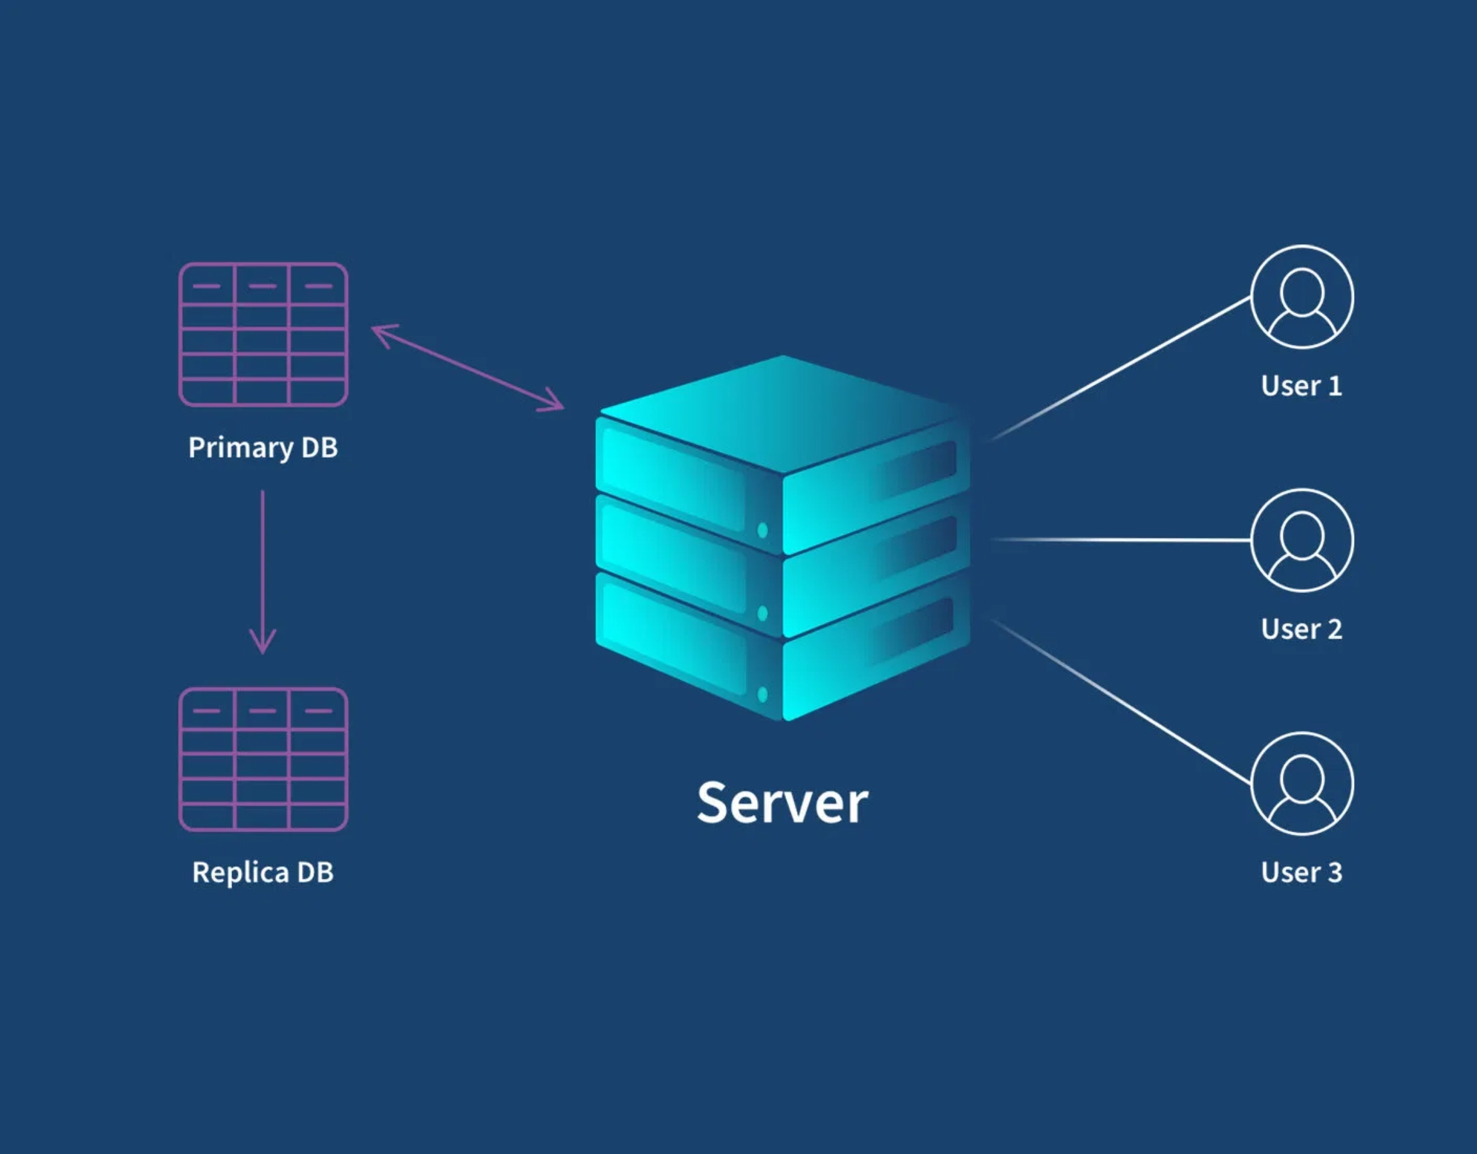



Data & Storage Strategies
SQL vs NoSQL Databases
Feature
SQL
NoSQL
Structure
Rigid schema
Flexible schema
Scaling
Vertical (primarily)
Horizontal (easily)
Consistency
Strong (ACID)
Eventually consistent
Best for
Complex queries
High throughput
Performance Strategies
Caching & CDN
Implement Redis/Memcached for data caching and CDNs for static content delivery
Data Replication
Use read replicas for scaling read operations and reducing primary database load
Backup Strategy
Implement automated, regular backups with point-in-time recovery capabilities
10

Slide 9

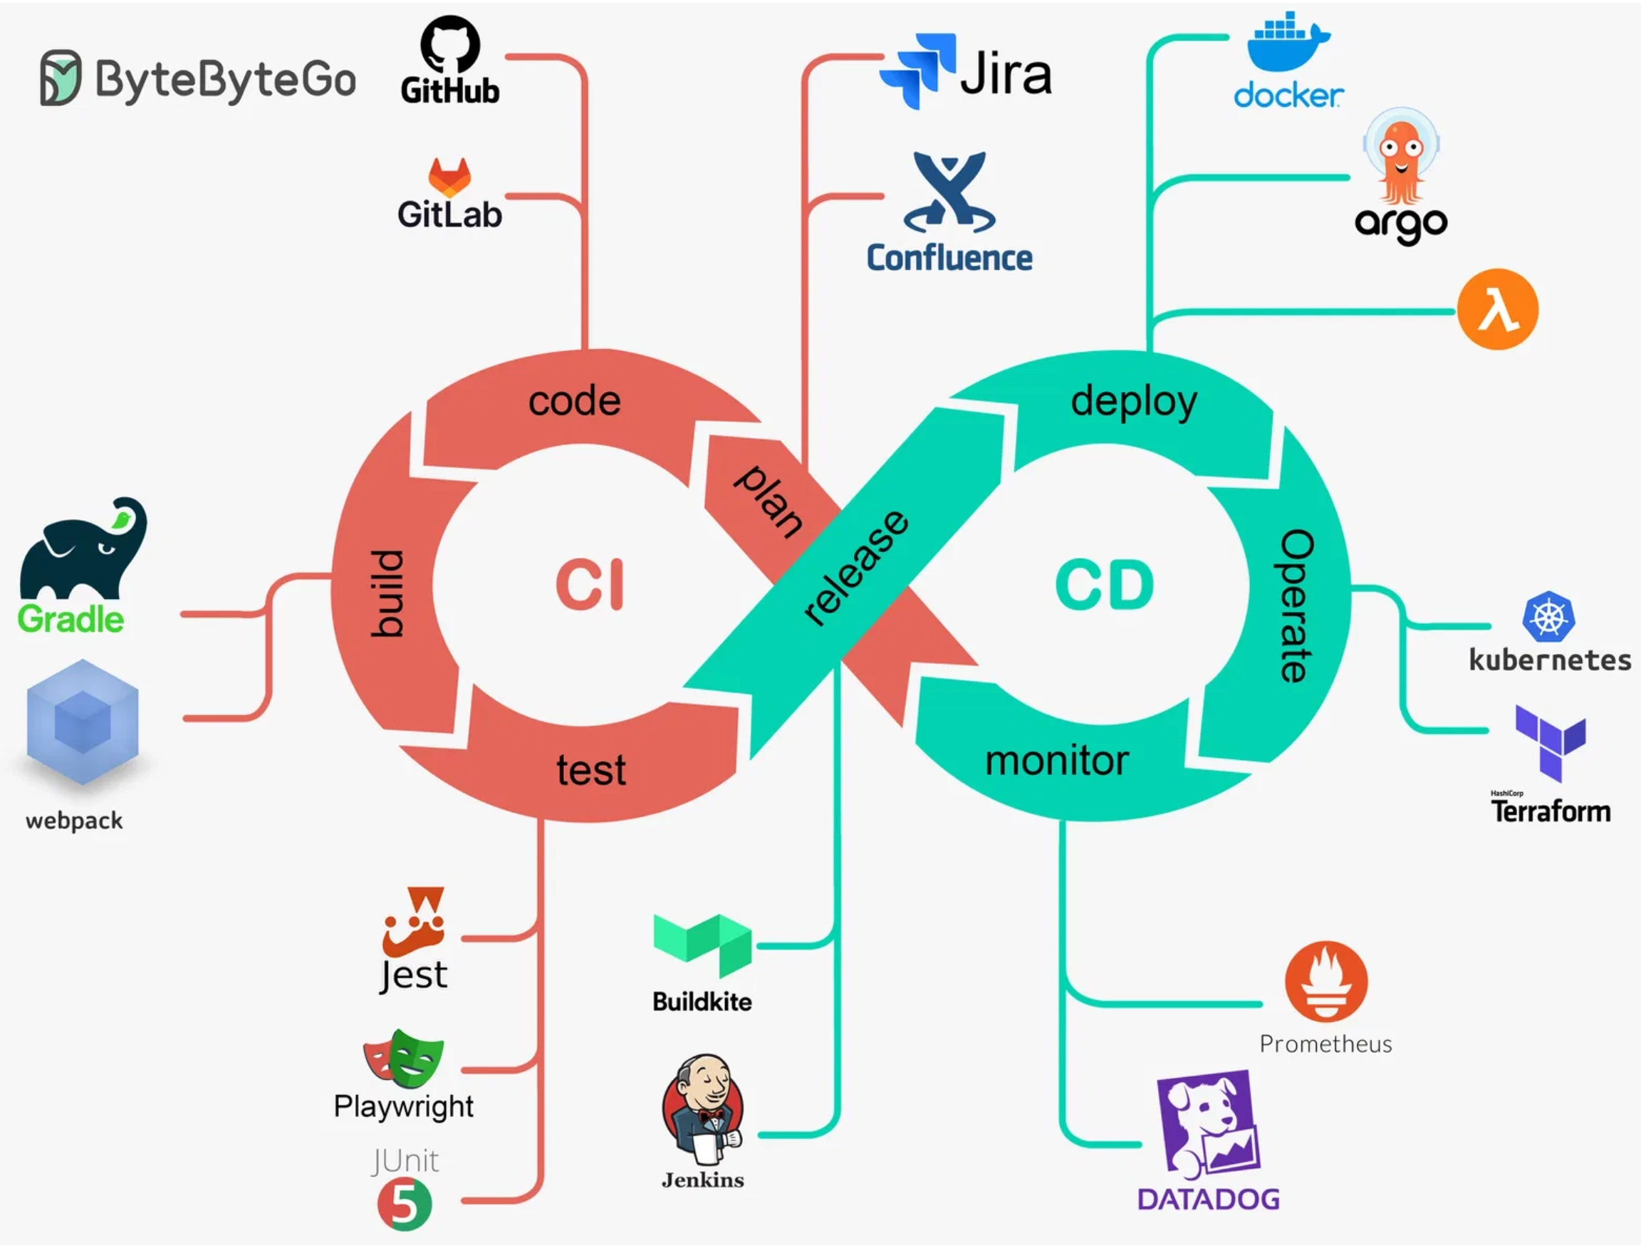
Continuous Deployment
Deployment Strategies
Blue-Green Deployment
Maintain two identical environments (blue and green). Deploy new version to inactive environment, test, then switch traffic. Enables instant rollback by switching back.
Canary Deployment
Release new version to a small subset of users first. Gradually increase traffic to the new version while monitoring for issues. Minimizes impact of potential problems.
Monitoring & Logging
Application performance
Infrastructure metrics
Error tracking
User experience
Centralized logging
Alerting systems
Distributed tracing
Dashboards
11

Slide 10


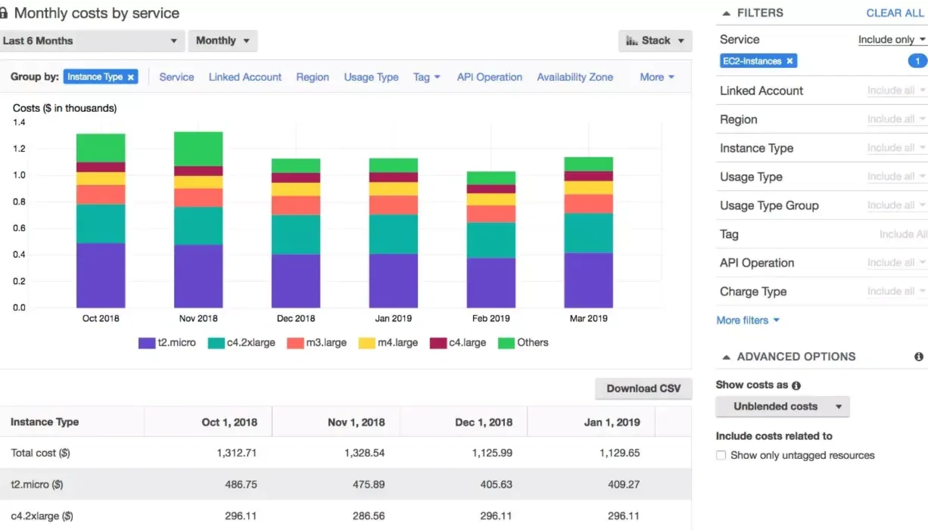


Cost Optimization
Pricing Models
Pay-as-you-go
Pay only for what you use. Ideal for variable workloads and early-stage startups with unpredictable usage patterns. No upfront commitment required.
Reserved Instances
Commit to 1-3 year terms for significant discounts (up to 75%). Best for stable, predictable workloads with known capacity requirements.
Auto-scaling for Efficiency
Scale resources up during peak times and down during low-demand periods. Automatically match capacity to actual demand to avoid over-provisioning.
Cost Management Best Practices
Set up detailed cost allocation tags
Implement budget alerts and thresholds
Regularly review unused resources
Use spot instances for non-critical workloads
Optimize storage tiers based on access patterns
12

Slide 11




Case Studies
Dropbox
Zoom
Scaling Storage Globally
Handling Pandemic Surge
Migrated from AWS to hybrid cloud infrastructure
Scaled from 10 million to 300+ million daily meeting participants
Built custom storage system (Magic Pocket) for better control
Rapidly expanded AWS cloud infrastructure across 17 global regions
Implemented global edge network for content delivery
Implemented auto-scaling for unpredictable demand patterns
Optimized data transfer protocols for efficiency
Optimized video delivery with regional data centers
Manages over 1 exabyte of data with custom infrastructure
3,000% growth in 3 months without major outages
Key Takeaway: Cloud infrastructure enabled rapid, global scaling that would have been impossible with traditional on-premise solutions
13

Slide 12






Common Pitfalls
Premature Optimization
Over-engineering solutions before understanding actual scaling needs. Building complex systems when simple ones would suffice.
Solution: Start simple, measure real usage, then optimize based on data.
Ignoring Security at Scale
Focusing on growth while neglecting security concerns. Failing to implement proper IAM, network security, and encryption.
Solution: Build security into your architecture from day one.
Vendor Lock-in
Becoming overly dependent on proprietary services that are difficult to migrate away from. Limiting future flexibility.
Solution: Use abstraction layers and consider multi-cloud strategies.
Poor Monitoring
Lacking visibility into system performance and user experience. Unable to detect issues before they impact customers.
Solution: Implement comprehensive monitoring and alerting systems.
14

Slide 13





From Startup to Global
Strategies for Global Scale
Growth Mindset & Cloud-First Approach
Design with scale in mind from day one. Choose technologies and architectures that can grow with your business. Embrace cloud-native principles.
Start Small, Scale Fast
Begin with minimal viable infrastructure. Use managed services to reduce operational overhead. Implement auto-scaling early to handle growth spurts.
Think Globally from the Start
Consider multi-region deployment early. Design for latency and data sovereignty requirements. Leverage CDNs and edge computing for global reach.
Build the Right Team
"The cloud is to startups what electricity was to the industrial revolution – an essential utility that enables unprecedented innovation and scale."
Invest in cloud expertise or partner with specialists. Foster a culture of continuous learning and adaptation. Embrace DevOps practices.
- Werner Vogels, CTO of Amazon
15

Slide 14








Takeaways
Cloud is an Enabler, Not a Silver Bullet
Cloud provides tools and infrastructure, but success still depends on good architecture, planning, and execution.
Design for Scale Early
Build with scalability in mind from the beginning. It's easier to scale a well-designed system than to refactor later.
Monitor, Iterate, Optimize Continuously
Scaling is an ongoing process, not a one-time event. Continuously measure, learn, and improve.
Learn from Real-World Success Stories
Thank You!
Study how other startups scaled successfully and adapt their strategies to your unique situation.
example@email.com
www.example.com
16

Slide 15
Takeaways
Cloud is an Enabler, Not a Silver Bullet
Cloud provides tools and infrastructure, but success still depends on good architecture, planning, and execution.
Design for Scale Early
Build with scalability in mind from the beginning. It's easier to scale a well-designed system than to refactor later.
Monitor, Iterate, Optimize Continuously
Scaling is an ongoing process, not a one-time event. Continuously measure, learn, and improve.
Learn from Real-World Success Stories
Thank You!
Study how other startups scaled successfully and adapt their strategies to your unique situation.
example@email.com
www.example.com
16

